Slide 1
XAMPP
PRESENT BY:
JUSAYAN, JUVELYN S.
BSIT-2A

Slide 2
What is Xampp?
- Is a free and open-source cross-platform web server solution stack package developed by Apache Friends, consisting mainly of the Apache HTTP Server, MariaDB database, and interpreters for scripts written in the PHP and Perl programming languages.

Slide 3
Why Use XAMPP ?
- Is an abbreviation for cross-platform, Apache, MySQL, PHP and Perl, and it allows you to build WordPress site offline, on a local web server on your computer. This simple and lightweight solution works on Windows, Linux, and Mac – hence the “cross-platform” part.
ADD YOUR WEBSITE

Slide 4
Installing with Windows :
•Go to the XAMPP website, choose XAMPP Windows.
•Choose latest stable version and click the installer file to initiate download.
•XAMPP for Windows exists in three different flavors:
•Installer : Probably the most comfortable way to install XAMPP.
•ZIP : For purists: XAMPP as ordinary ZIP archive.
•7zip : For purists with low bandwidth: XAMPP as 7zip archive.
•You can also download XAMPP for Windows
Add-Ons :
•Tomcat Add-On
•Perl Add-On
How to Install XAMPP

Slide 5
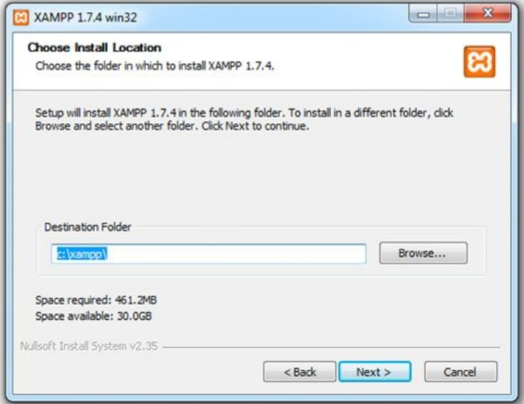
How to Install XAMPP
Installation with the Installer :
•Using the installer version is the easiest way to install XAMPP.XAMPP

Slide 6
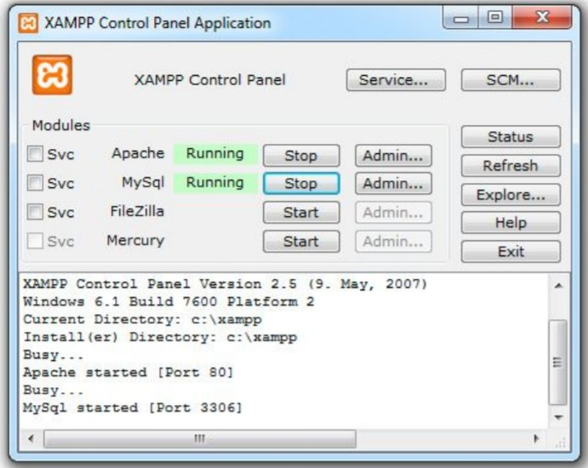
How to Install XAMPP
Installation with the Installer :
•After the installation is complete, you will find XAMPP under Start | Programs |
XAMPP. You can use the XAMPP Control Panel to start/stop all server and also
install/uninstall services.

Slide 7
Installation with the Installer :
•The XAMPP control panel for start/stop Apache, MySQL, FilaZilla &
Mercury or install these server as services.XAMPP
How to Install XAMPP

Slide 8
How to Install XAMPP
Installation without the Installer :
•Unzip the zip archives into the folder of your choice. XAMPP is extracting
to the subdirectory "[Ziel]\xampp" below the selected target directory. Now
start the file "setup_xampp.bat", to adjust the XAMPP configuration to your
system.
• If you choose a root directory "C:\" as target, you must not start
"setup_xampp.bat".
•If you extract XAMPP in a top level folder like "C:\" or "D:\", you can start
most servers like Apache or MySQL directly without execution of the file
"setup_xampp.bat".

Slide 9
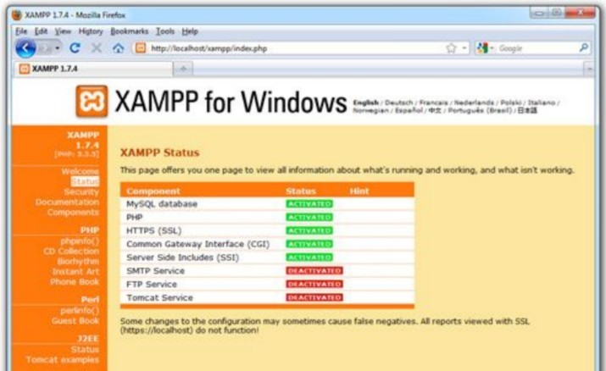
How to Install XAMPP
Testing XAMPP:
•After starting of Apache (and MySQL),
go to the address http://localhost/After
starting of Apache (and MySQL),
go to the address http://localhost/ or
http://127.0.0.1/
in your browser and examine all of
the XAMPP examples and
toolsInstallation

Slide 10
Present to:
NITURA, JAYSON
THANK YOU !

